Slide 1

FOR PURPOSES OF FORAGE VIRTUAL WORK EXPERIENCE PROGRAM
WEB SCRAPING TO GAIN COMPANY INSIGHTS
04/06/2023

Slide 2
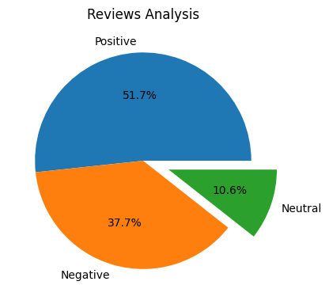
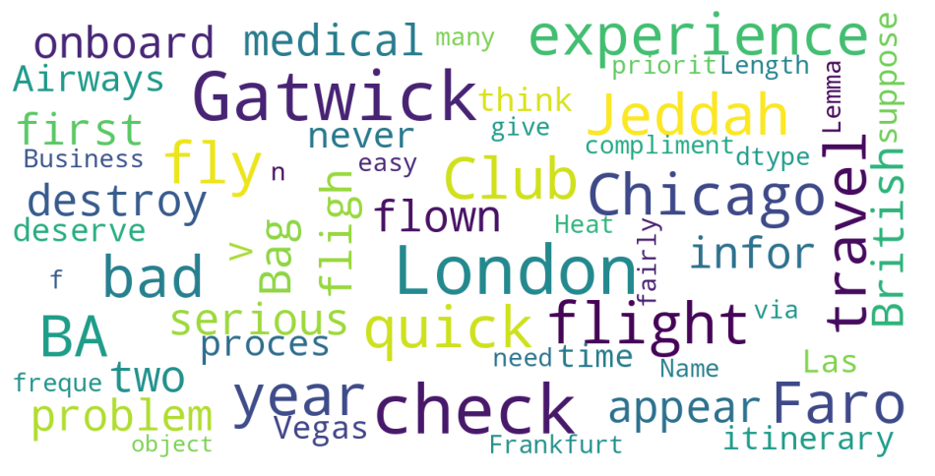
INSIGHTS FROM CUSTOMER REVIEWS
From cleaning 1000 reviews given by the customers, we obtained
Positive - 517
Negative - 377
Neutral - 106
Word cloud of keywords used in reviews

